Slide 1
Bray Team Week 11 Update
Avery Haynes, Locke Lehmann, Travis Carlson, Cody Sims, Zachary Walker, Michael Hager
4/8/2024

Slide 2
Weekly Deliverables
Tasks | Lead | Percentage Done | Notes
Begin potentiometer validation testing | Avery/Michael | 100% | Completed.
Strain Gauge Measurement | Avery/ Michael | 75% | Attached boards and jumper wires.
Test motor system | Cody/Travis | 90% | Got readings, working on equation for torque.
Implement strain gauges into stop bolts | Zack | 100% | Completed
Prep Hall effect sensor Test | Locke/Travis | 100% | Printed and attached test rig.

Slide 3
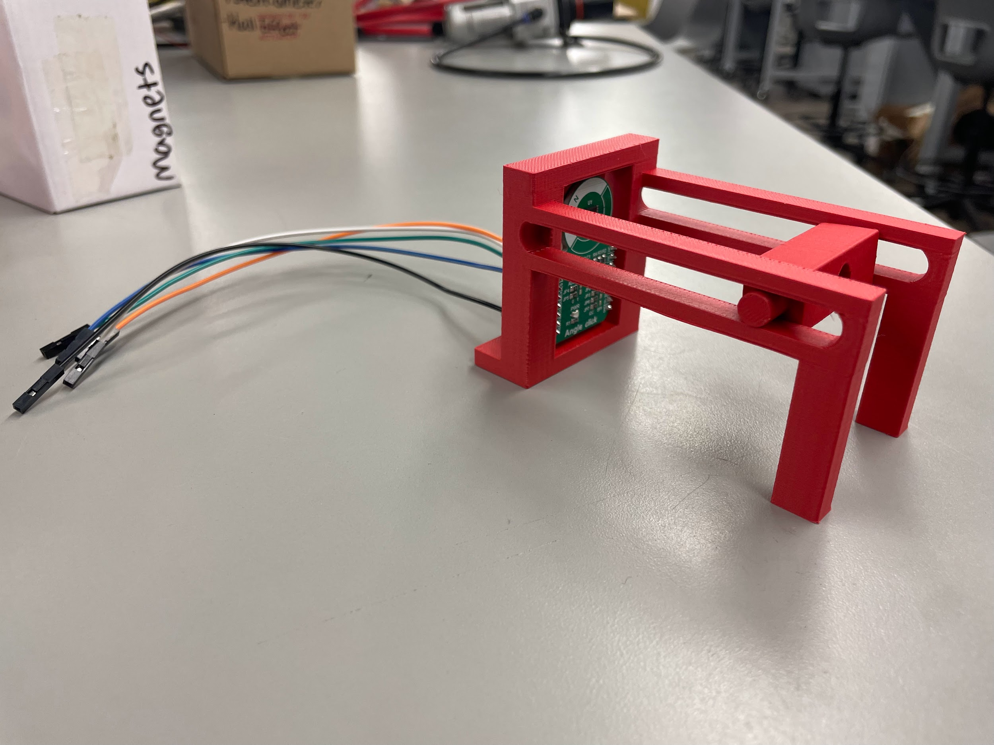
Hall Effect Sensor
Attached wires to sensor and frame
Pi not detecting sensor-still working on that
Rig works as expected

Slide 4
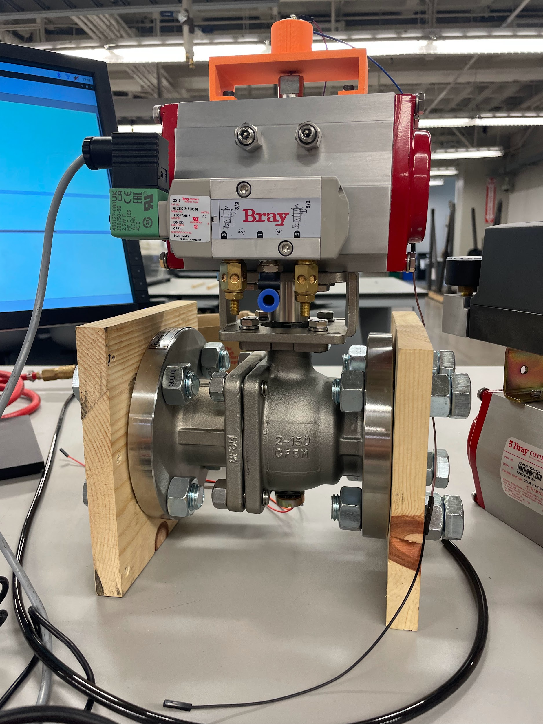
Electric Motor
Got readings from Pi
Still working on formula for torque

Slide 5
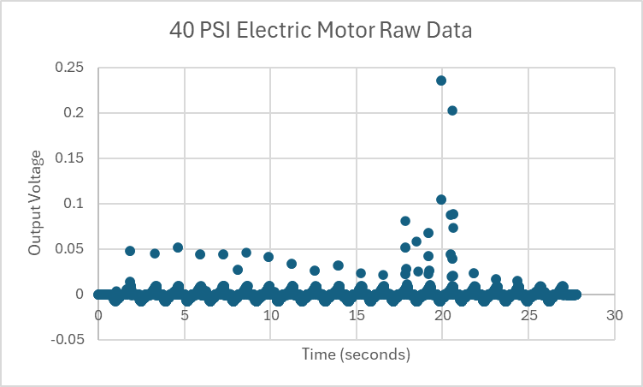
Electric Motor
Raw data (no filter)

Slide 6
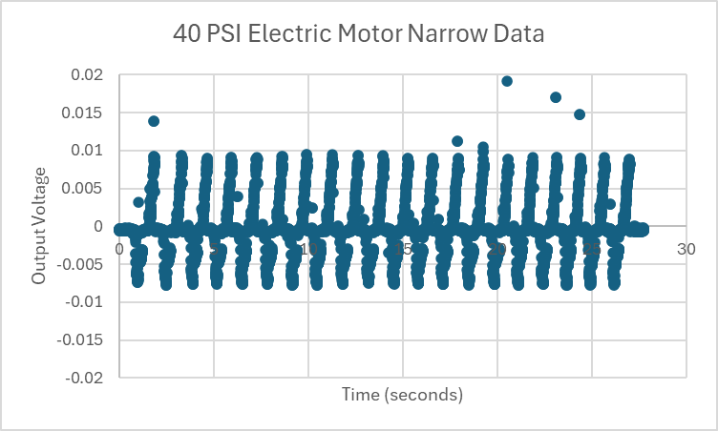
Electric Motor
Filtered data (only negates ~30 points out of over 6400 - 0.4% bad data)
Good pattern
Same pattern across all PSI values

Slide 7
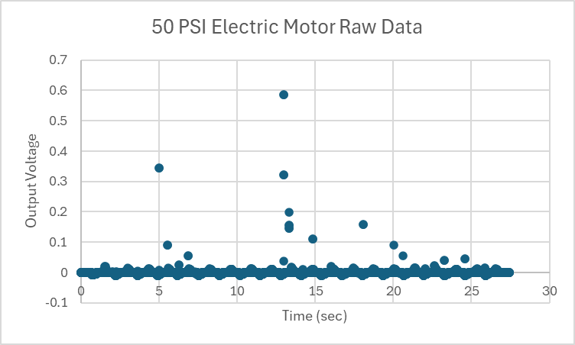
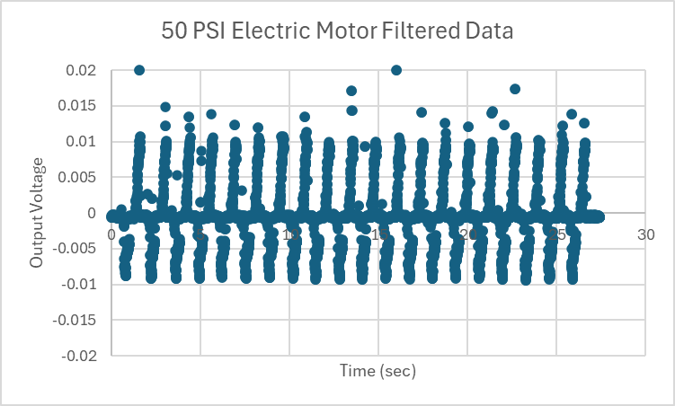
Electric Motor

Slide 8
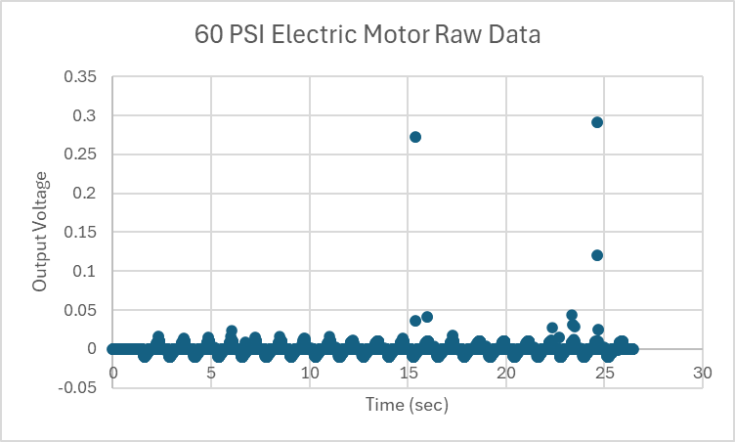
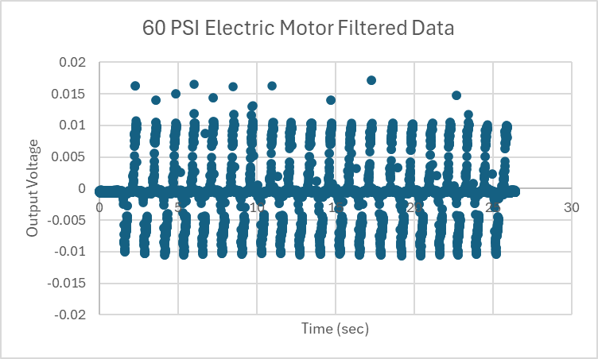
Electric Motor

Slide 9
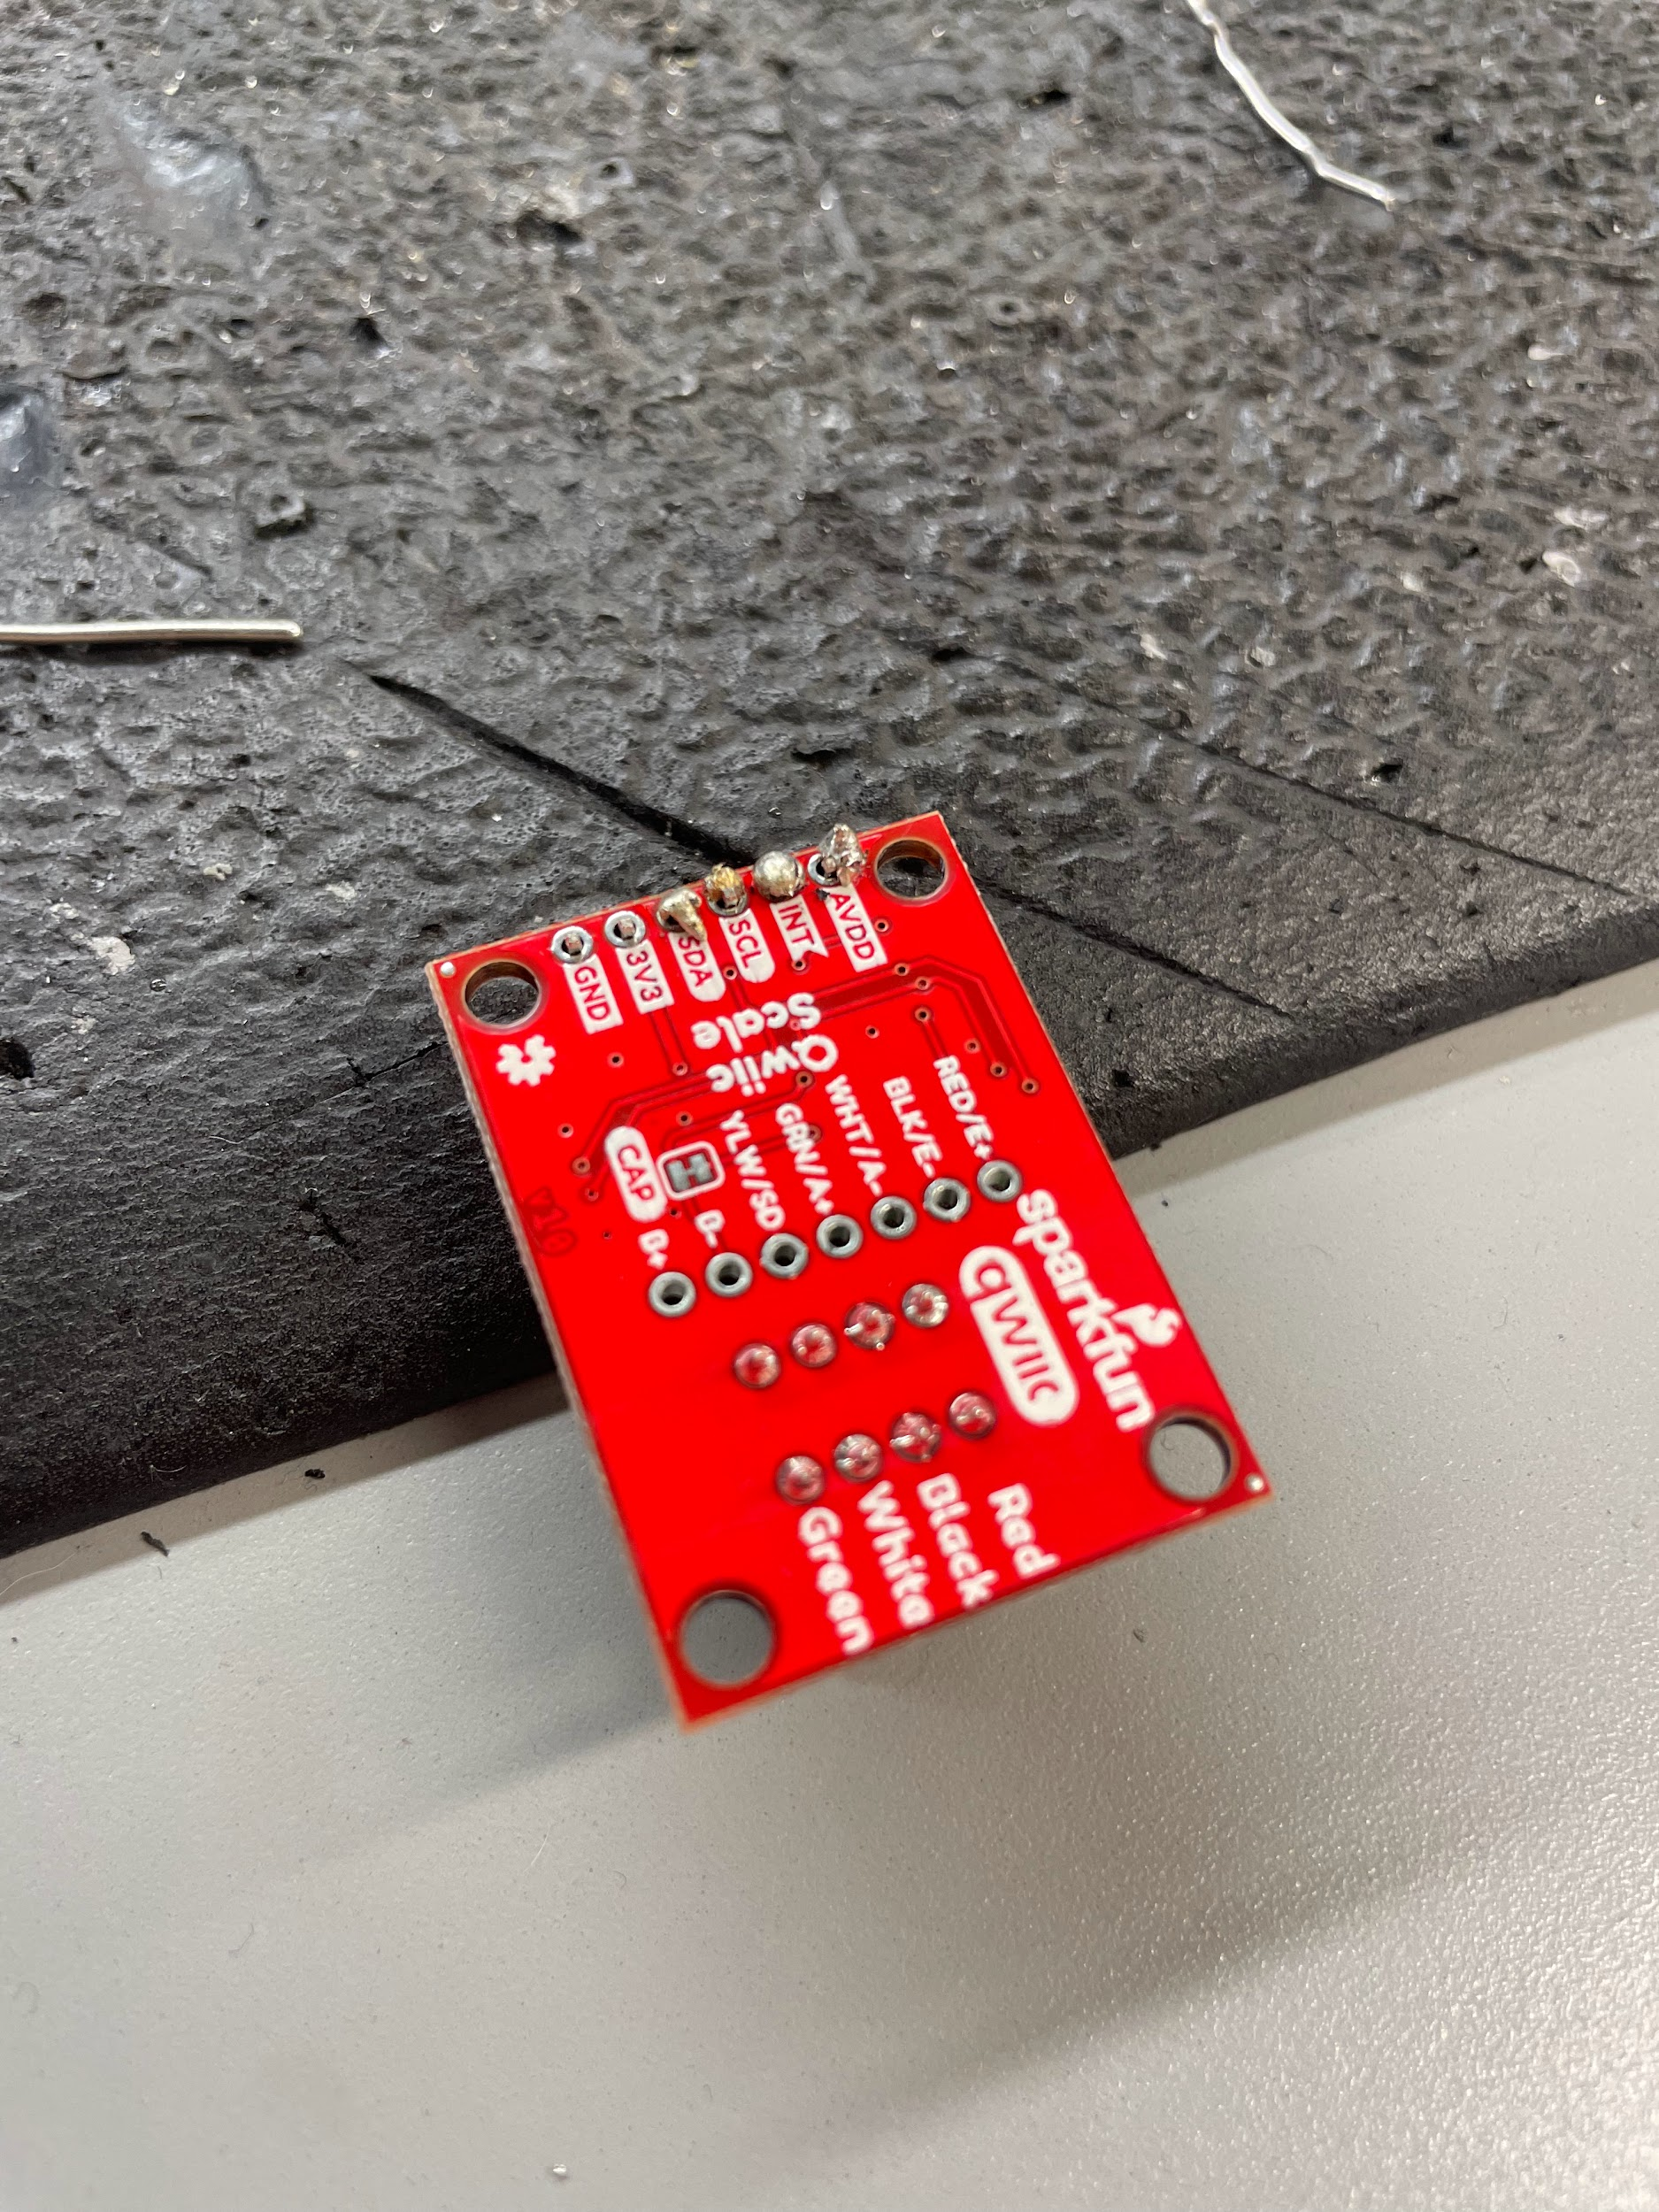
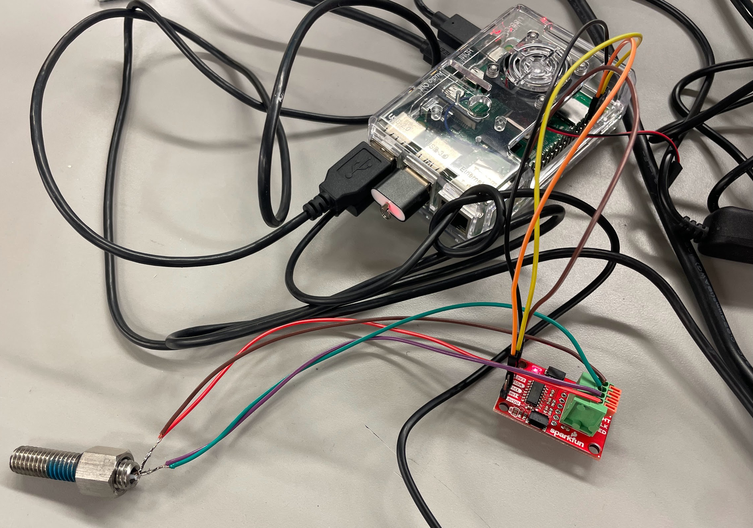
Strain Gauges
Soldered gauges to amplifier board and attached to Pi
Reads raw values, ready for installation into actuator

Slide 10
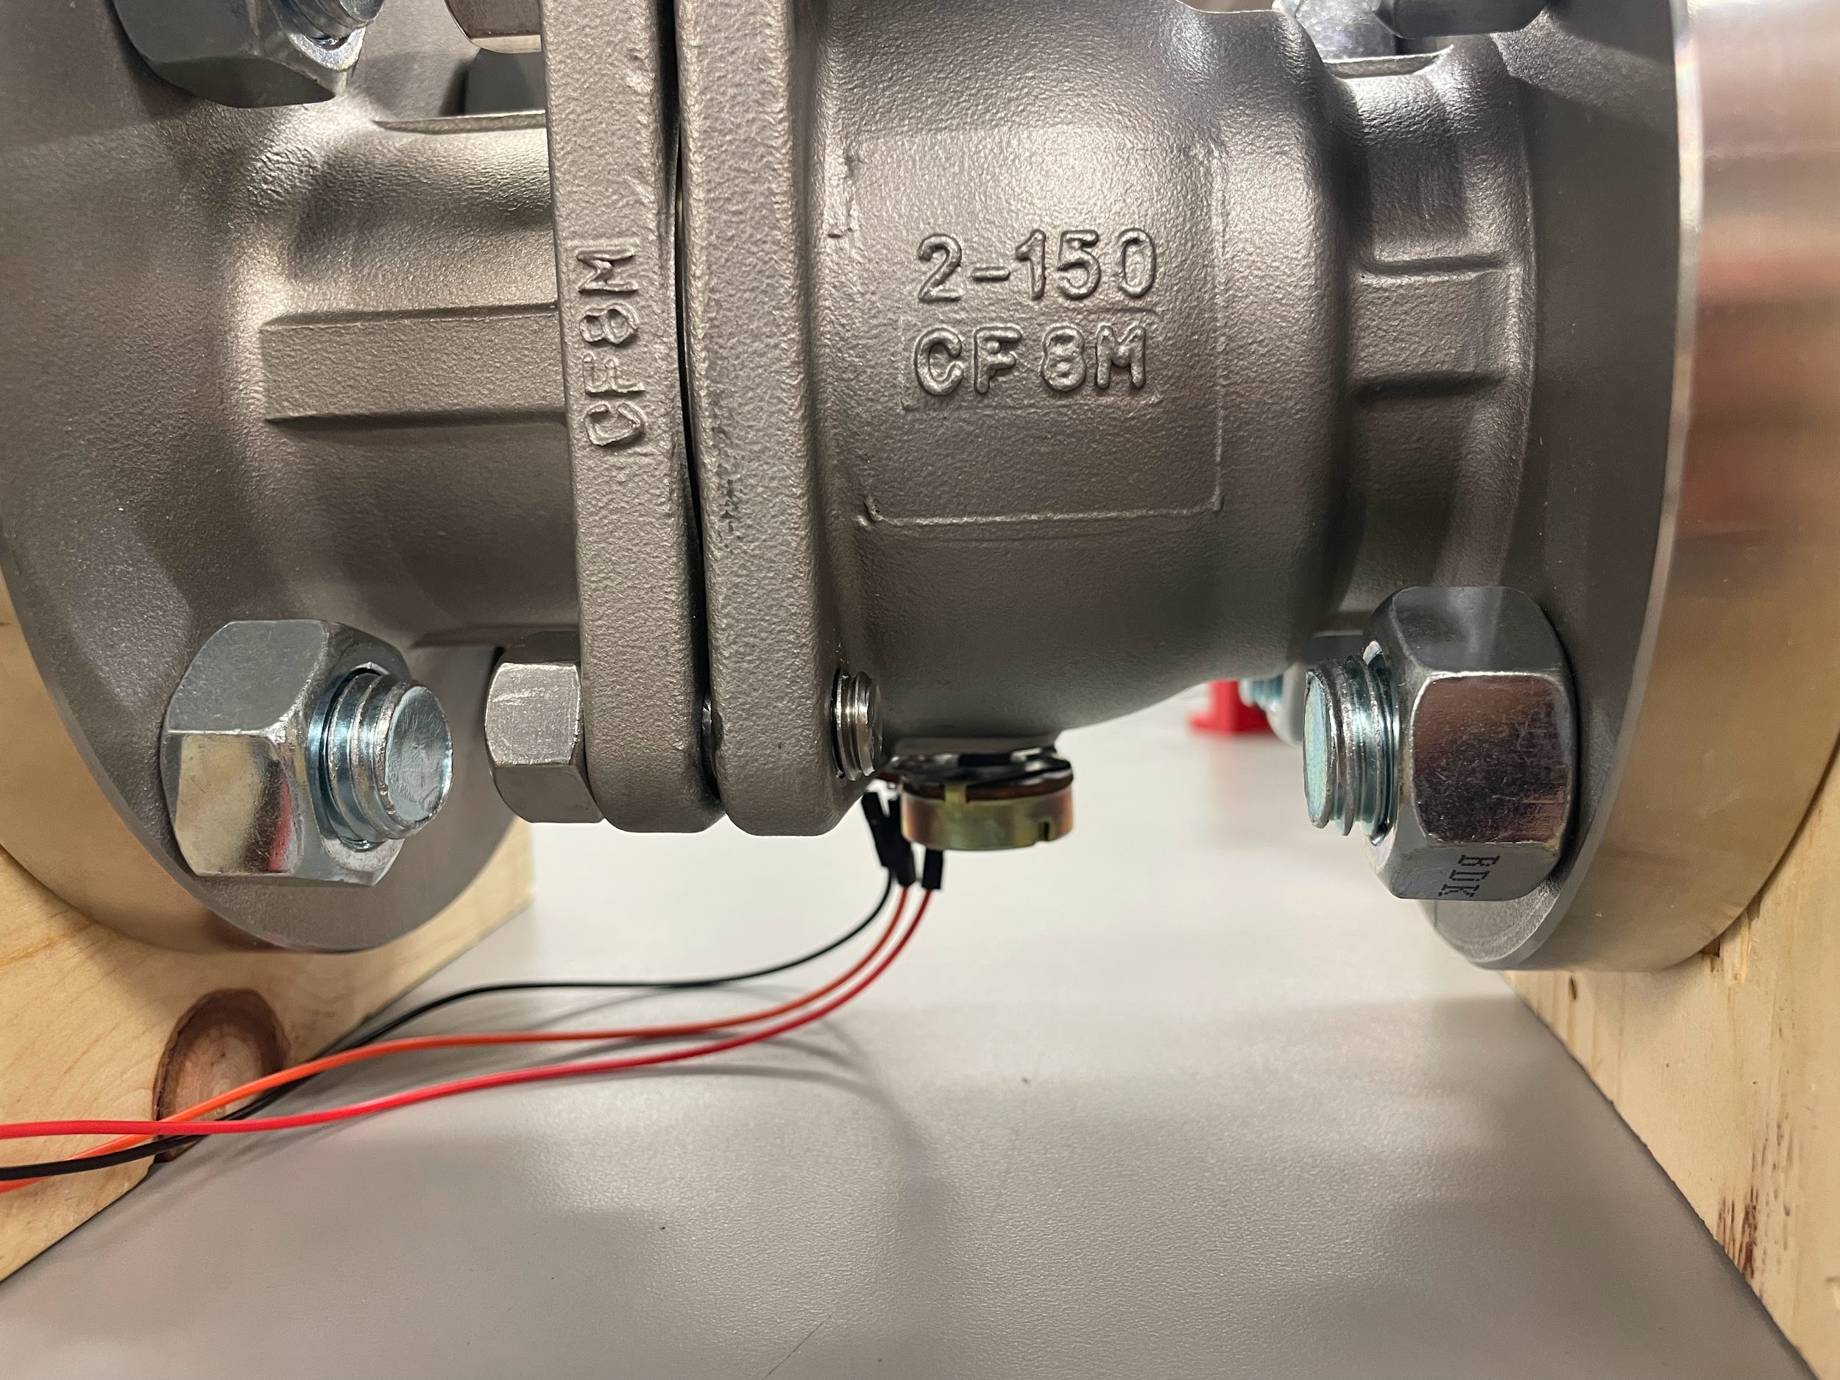
Potentiometer
Glued potentiometer into valve and actuated
Got readings from Pi
Difficulty with stability of glue and alignment, but consistent readings

Slide 11
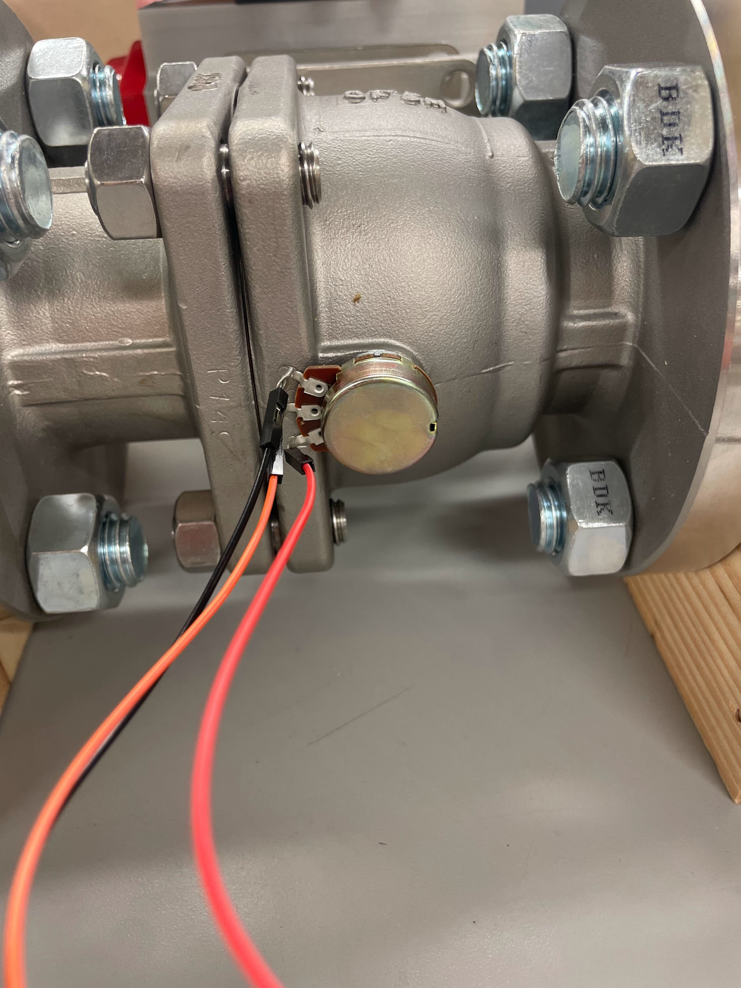
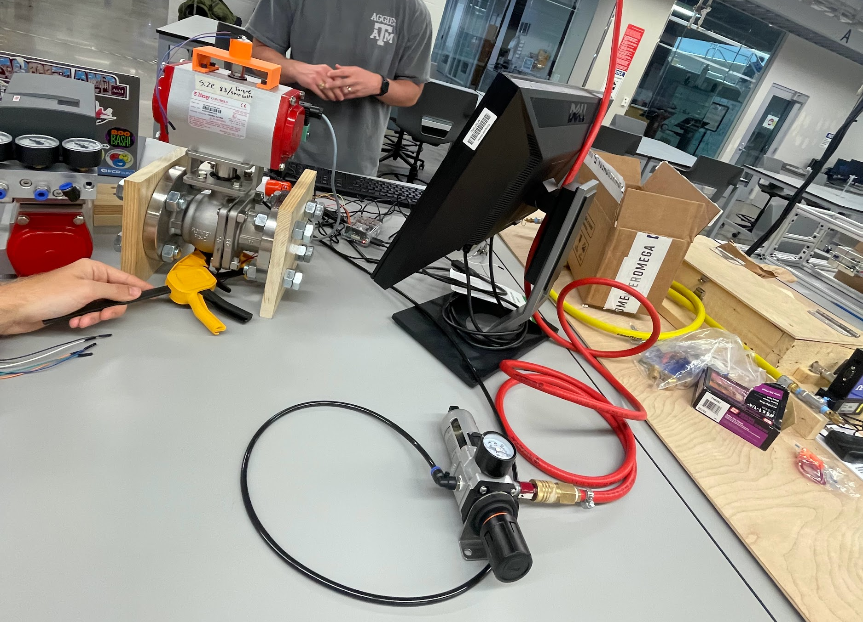
Potentiometer

Slide 12
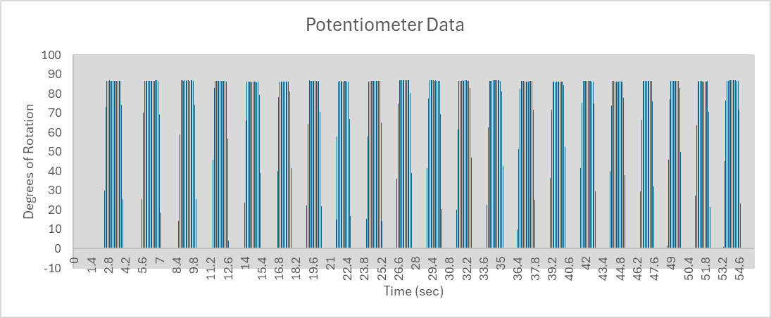
Potentiometer

Slide 13
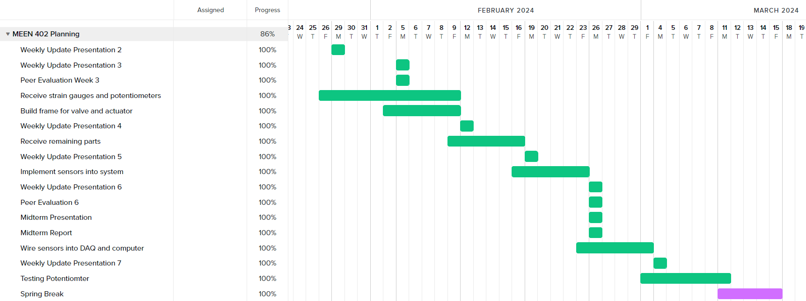
Gantt Chart

Slide 14
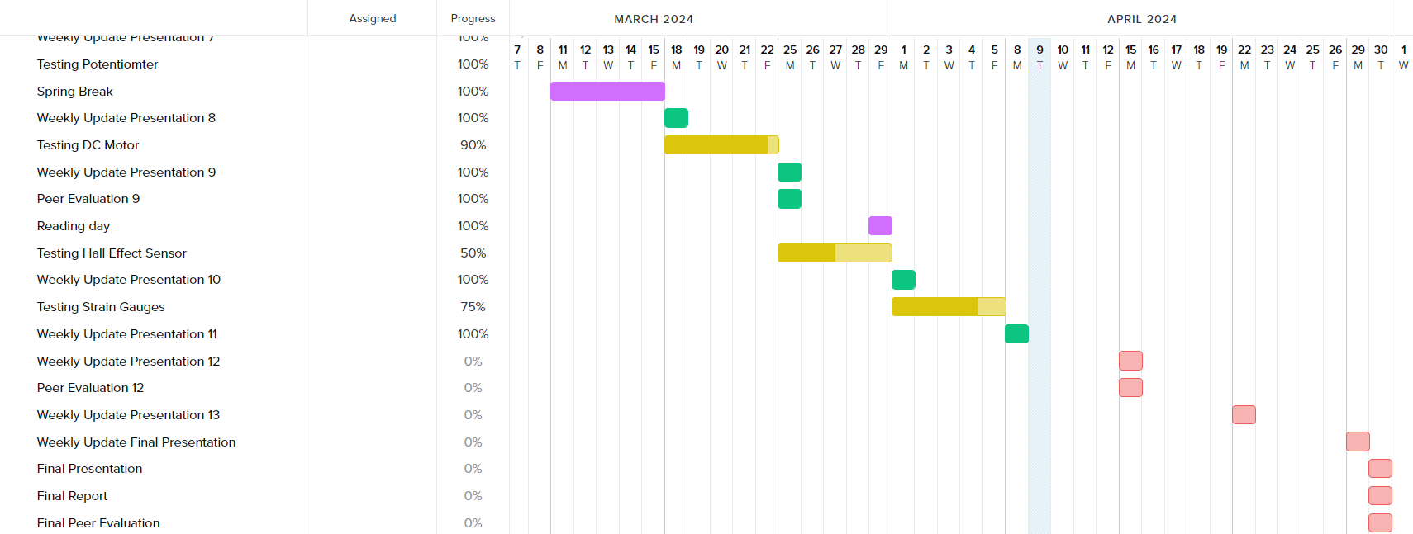
Gantt Chart

Slide 15
Next Week’s Deliverables
Tasks | Lead | Percentage Done | Notes
Begin potentiometer validation testing | Avery/Michael | 50% | Do more test runs.
Strain Gauge Measurement | Zack/ Michael | 75% | Attached boards and jumper wires, get readings
Test motor system | Cody/Travis | 90% | Got readings, working on equation for torque.
Hall effect sensor Test | Locke/Travis | 50% | Get data readings.

